Slide 1
Building Java Programs Chapter 8
Classes

Slide 2
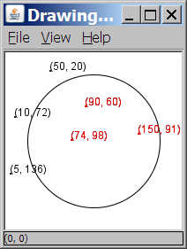
A programming problem
Given a file of cities' (x, y) coordinates, which begins with the number of cities:
6
50 20
90 60
10 72
74 98
5 136
150 91
Write a program to draw the cities on a DrawingPanel, then drop a "bomb" that turns all cities red that are within a given radius:
Blast site x? 100
Blast site y? 100
Blast radius? 75
Kaboom!

Slide 3
A bad solution
Scanner input = new Scanner(new File("cities.txt"));
int cityCount = input.nextInt();
int[] xCoords = new int[cityCount];
int[] yCoords = new int[cityCount];
for (int i = 0; i < cityCount; i++) {
xCoords[i] = input.nextInt(); // read each city
yCoords[i] = input.nextInt();
}
...
parallel arrays: 2+ arrays with related data at same indexes.
Considered poor style.

Slide 4
Observations
The data in this problem is a set of points.
It would be better stored as Point objects.
A Point would store a city's x/y data.
We could compare distances between Points to see whether the bomb hit a given city.
Each Point would know how to draw itself.
The overall program would be shorter and cleaner.

Slide 5

Clients of objects
client program: A program that uses objects.
Example: Bomb is a client of DrawingPanel and Graphics.
Bomb.java (client program)
public class Bomb {
main(String[] args) {
new DrawingPanel(...)
new DrawingPanel(...)
...
}
}
DrawingPanel.java (class)
public class DrawingPanel {
...
}

Slide 6
Classes and objects
class: A program entity that represents either:
1. A program / module, or
2. A template for a new type of objects.
The DrawingPanel class is a template for creating DrawingPanel objects.
object: An entity that combines state and behavior.
object-oriented programming (OOP): Programs that perform their behavior as interactions between objects.

Slide 7
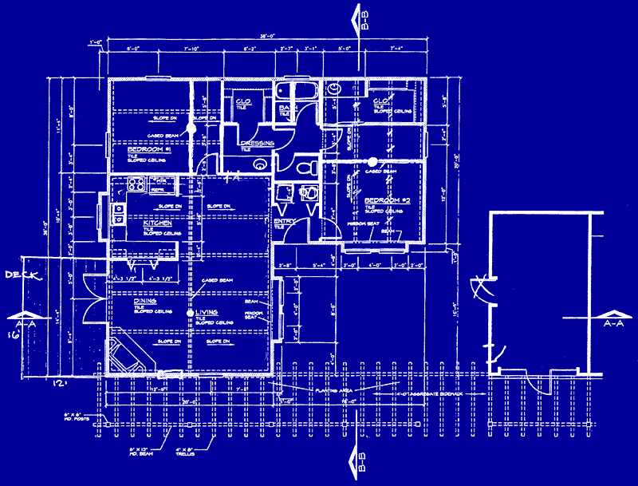
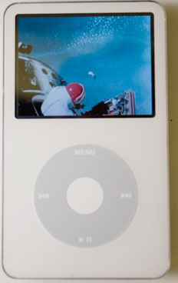
Blueprint analogy
iPod blueprint
state: current song volume battery life
behavior: power on/off change station/song change volume choose random song
creates
iPod #1
state: song = "1,000,000 Miles" volume = 17 battery life = 2.5 hrs
behavior: power on/off change station/song change volume choose random song
iPod #2
state: song = "Letting You" volume = 9 battery life = 3.41 hrs
behavior: power on/off change station/song change volume choose random song
iPod #3
state: song = "Discipline" volume = 24 battery life = 1.8 hrs
behavior: power on/off change station/song change volume choose random song

Slide 8
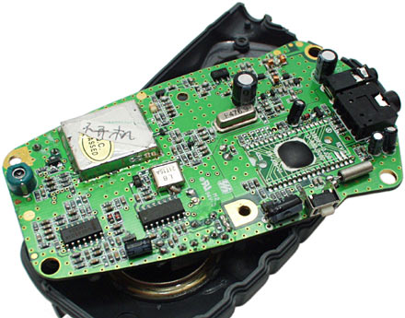
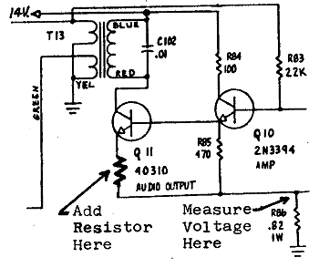
Abstraction
abstraction: A distancing between ideas and details.
We can use objects without knowing how they work.
abstraction in an iPod:
You understand its external behavior (buttons, screen).
You don't understand its inner details, and you don't need to.

Slide 9
Our task
In the following slides, we will implement a Point class as a way of learning about defining classes.
We will define a type of objects named Point.
Each Point object will contain x/y data called fields.
Each Point object will contain behavior called methods.
Client programs will use the Point objects.

Slide 10
Point objects (desired)
Point p1 = new Point(5, -2);
Point p2 = new Point(); // origin, (0, 0)
Data in each Point object:
Methods in each Point object:
Field name | Description
x | the point's x-coordinate
y | the point's y-coordinate
Method name | Description
setLocation(x, y) | sets the point's x and y to the given values
translate(dx, dy) | adjusts the point's x and y by the given amounts
distance(p) | how far away the point is from point p
draw(g) | displays the point on a drawing panel

Slide 11
Point class as blueprint
Point class
state: int x, y
behavior: setLocation(int x, int y) translate(int dx, int dy) distance(Point p) draw(Graphics g)
The class (blueprint) will describe how to create objects.
Each object will contain its own data and methods.
Point object #1
state: x = 5, y = -2
behavior: setLocation(int x, int y) translate(int dx, int dy) distance(Point p) draw(Graphics g)
Point object #2
state: x = -245, y = 1897
behavior: setLocation(int x, int y) translate(int dx, int dy) distance(Point p) draw(Graphics g)
Point object #3
state: x = 18, y = 42
behavior: setLocation(int x, int y) translate(int dx, int dy) distance(Point p) draw(Graphics g)

Slide 12
Object state: Fields

Slide 13
Point class, version 1
public class Point {
int x;
int y;
}
Save this code into a file named Point.java.
The above code creates a new type named Point.
Each Point object contains two pieces of data:
an int named x, and
an int named y.
Point objects do not contain any behavior (yet).

Slide 14
Fields
field: A variable inside an object that is part of its state.
Each object has its own copy of each field.
Declaration syntax:
type name;
Example:
public class Student {
String name; // each Student object has a
double gpa; // name and gpa field
}

Slide 15
Accessing fields
Other classes can access/modify an object's fields.
access: variable.field
modify: variable.field = value;
Example:
Point p1 = new Point();
Point p2 = new Point();
System.out.println("the x-coord is " + p1.x); // access
p2.y = 13; // modify

Slide 16
A class and its client
Point.java is not, by itself, a runnable program.
A class can be used by client programs.
Point.java (class of objects)
public class Point {
int x;
int y;
}
PointMain.java (client program)
public class PointMain {
main(String args) {
Point p1 = new Point();
p1.x = 7;
p1.y = 2;
Point p2 = new Point();
p2.x = 4;
p2.y = 3;
...
}
}
x | 7 | y | 2
x | 4 | y | 3

Slide 17
PointMain client example
public class PointMain {
public static void main(String[] args) {
// create two Point objects
Point p1 = new Point();
p1.y = 2;
Point p2 = new Point();
p2.x = 4;
System.out.println(p1.x + ", " + p1.y); // 0, 2
// move p2 and then print it
p2.x += 2;
p2.y++;
System.out.println(p2.x + ", " + p2.y); // 6, 1
}
}
Exercise: Modify the Bomb program to use Point objects.

Slide 18
Arrays of objects
null : A value that does not refer to any object.
The elements of an array of objects are initialized to null.
String[] words = new String[5];
DrawingPanel[] windows = new DrawingPanel[3];
index | 0 | 1 | 2 | 3 | 4
value | null | null | null | null | null
words
index | 0 | 1 | 2
value | null | null | null
windows

Slide 19
Things you can do w/ null
store null in a variable or an array element
String s = null;
words[2] = null;
print a null reference
System.out.println(s); // null
ask whether a variable or array element is null
if (words[2] == null) { ...
pass null as a parameter to a method
System.out.println(null); // null
return null from a method (often to indicate failure)
return null;

Slide 20
Null pointer exception
dereference: To access data or methods of an object with the dot notation, such as s.length() .
It is illegal to dereference null (causes an exception).
null is not any object, so it has no methods or data.
String[] words = new String[5];
System.out.println("word is: " + words[0]);
words[0] = words[0].toUpperCase(); // ERROR
Output:
word is: null
Exception in thread "main" java.lang.NullPointerException
at Example.main(Example.java:8)
index | 0 | 1 | 2 | 3 | 4
value | null | null | null | null | null

Slide 21
Looking before you leap
You can check for null before calling an object's methods.
String[] words = new String[5];
words[0] = "hello";
words[2] = "goodbye"; // words[1], [3], [4] are null
for (int i = 0; i < words.length; i++) {
if (words[i] != null) {
words[i] = words[i].toUpperCase();
}
}
index | 0 | 1 | 2 | 3 | 4
value | "HELLO" | null | "GOODBYE" | null | null
words

Slide 22
Two-phase initialization
1) initialize the array itself (each element is initially null)
2) initialize each element of the array to be a new object
String[] words = new String[4]; // phase 1
for (int i = 0; i < words.length; i++) {
coords[i] = "word" + i; // phase 2
}
index | 0 | 1 | 2 | 3
value | “green" | "word1" | "word2" | "word3"
words

Slide 23
Bomb answer 1
import java.awt.*;
import java.io.*;
import java.util.*;
// Displays a set of cities and simulates dropping a "bomb" on them.
public class Bomb {
public static void main(String[] args) throws FileNotFoundException {
DrawingPanel panel = new DrawingPanel(200, 200);
Graphics g = panel.getGraphics();
Scanner input = new Scanner(new File("cities.txt"));
Point[] cities = readCities(input, g);
// drop the "bomb"
Scanner console = new Scanner(System.in);
Point bomb = new Point();
System.out.print("Blast site x? ");
bomb.x = console.nextInt();
System.out.print("Blast site y? ");
bomb.y = console.nextInt();
System.out.print("Blast radius? ");
int radius = console.nextInt();
boom(bomb, radius, cities, g);
}
...

Slide 24
Bomb answer 2
// Reads input file of cities and returns them as array of Points.
public static Point[] readCities(Scanner input, Graphics g) {
int numCities = input.nextInt(); // first line = # of cities
Point[] cities = new Point[numCities];
for (int i = 0; i < cities.length; i++) {
cities[i] = new Point();
cities[i].x = input.nextInt(); // read city x/y from file
cities[i].y = input.nextInt();
g.fillOval(cities[i].x, cities[i].y, 3, 3);
g.drawString("(" + cities[i].x + ", " + cities[i].y + ")",
cities[i].x, cities[i].y);
}
return cities;
}
// Simulates dropping a bomb at the given location on the given cities.
public static void boom(Point bomb, int radius, Point[] cities, Graphics g) {
g.setColor(Color.RED);
g.drawOval(bomb.x - radius, bomb.y - radius, 2 * radius, 2 * radius);
for (int i = 0; i < cities.length; i++) {
int dx = cities[i].x - bomb.x;
int dy = cities[i].y - bomb.y;
double distance = Math.sqrt(dx * dx + dy * dy);
if (distance <= radius) {
g.fillOval(cities[i].x, cities[i].y, 3, 3);
g.drawString("(" + cities[i].x + ", " + cities[i].y + ")",
cities[i].x, cities[i].y);
}
}
System.out.println("Kaboom!");
}
}

Slide 25
Object behavior: Methods

Slide 26
Client code redundancy
Our client program wants to draw Point objects:
// draw each city
g.fillOval(cities[i].x, cities[i].y, 3, 3);
g.drawString("(" + cities[i].x + ", " + cities[i].y + ")",
cities[i].x, cities[i].y);
To draw them in other places, the code must be repeated.
We can remove this redundancy using a method.

Slide 27
Eliminating redundancy, v1
We can eliminate the redundancy with a static method:
// Draws the given point on the DrawingPanel.
public static void draw(Point p, Graphics g) {
g.fillOval(p.x, p.y, 3, 3);
g.drawString("(" + p.x + ", " + p.y + ")", p.x, p.y);
}
main would call the method as follows:
// draw each city
draw(cities[i], g);

Slide 28
Problem with static method
We are missing a major benefit of objects: code reuse.
Every program that draws Points would need a draw method.
The syntax doesn't match how we're used to using objects.
draw(cities[i], g); // static (bad)
The point of classes is to combine state and behavior.
The draw behavior is closely related to a Point's data.
The method belongs inside each Point object.
cities[i].draw(g); // inside object (better)

Slide 29
Instance methods
instance method (or object method): Exists inside each object of a class and gives behavior to each object.
public type name(parameters) {
statements;
}
same syntax as static methods, but without static keyword
Example:
public void shout() {
System.out.println("HELLO THERE!");
}

Slide 30
Instance method example
public class Point {
int x;
int y;
// Draws this Point object with the given pen.
public void draw(Graphics g) {
...
}
}
The draw method no longer has a Point p parameter.
How will the method know which point to draw?
How will the method access that point's x/y data?

Slide 31
Point objects w/ method
Each Point object has its own copy of the draw method, which operates on that object's state:
Point p1 = new Point();
p1.x = 7;
p1.y = 2;
Point p2 = new Point();
p2.x = 4;
p2.y = 3;
p1.draw(g);
p2.draw(g);
p1
public void draw(Graphics g) {
// this code can see p1's x and y
}
x | 7 | y | 2
public void draw(Graphics g) {
// this code can see p2's x and y
}
x | 4 | y | 3
p2

Slide 32
The implicit parameter
implicit parameter: The object on which an instance method is called.
During the call p1.draw(g); the object referred to by p1 is the implicit parameter.
During the call p2.draw(g); the object referred to by p2 is the implicit parameter.
The instance method can refer to that object's fields.
We say that it executes in the context of a particular object.
draw can refer to the x and y of the object it was called on.

Slide 33
Point class, version 2
public class Point {
int x;
int y;
// Changes the location of this Point object.
public void draw(Graphics g) {
g.fillOval(x, y, 3, 3);
g.drawString("(" + x + ", " + y + ")", x, y);
}
}
Each Point object contains a draw method that draws that point at its current x/y position.

Slide 34
Kinds of methods
accessor: A method that lets clients examine object state.
Examples: distance, distanceFromOrigin
often has a non-void return type
mutator: A method that modifies an object's state.
Examples: setLocation, translate

Slide 35
Mutator method questions
Write a method setLocation that changes a Point's location to the (x, y) values passed.
Write a method translate that changes a Point's location by a given dx, dy amount.
Modify the Point and client code to use these methods.

Slide 36
Mutator method answers
public void setLocation(int newX, int newY) {
x = newX;
y = newY;
}
public void translate(int dx, int dy) {
x = x + dx;
y = y + dy;
}
// alternative solution that utilizes setLocation
public void translate(int dx, int dy) {
setLocation(x + dx, y + dy);
}

Slide 37
Accessor method questions
Write a method distance that computes the distance between a Point and another Point parameter.
Use the formula:
Write a method distanceFromOrigin that returns the distance between a Point and the origin, (0, 0).
Modify the client code to use these methods.

Slide 38
Accessor method answers
public double distance(Point other) {
int dx = x - other.x;
int dy = y - other.y;
return Math.sqrt(dx * dx + dy * dy);
}
public double distanceFromOrigin() {
return Math.sqrt(x * x + y * y);
}
// alternative solution that uses distance
public double distanceFromOrigin() {
Point origin = new Point();
return distance(origin);
}

Slide 39
Printing objects
By default, Java doesn't know how to print objects:
Point p = new Point();
p.x = 10;
p.y = 7;
System.out.println("p is " + p); // p is Point@9e8c34
// better, but cumbersome; p is (10, 7)
System.out.println("p is (" + p.x + ", " + p.y + ")");
// desired behavior
System.out.println("p is " + p); // p is (10, 7)

Slide 40
The toString method
tells Java how to convert an object into a String
Point p1 = new Point(7, 2);
System.out.println("p1: " + p1);
// the above code is really calling the following:
System.out.println("p1: " + p1.toString());
Every class has a toString, even if it isn't in your code.
Default: class's name @ object's memory address (base 16)
Point@9e8c34

Slide 41
toString syntax
public String toString() {
code that returns a String representing this object;
}
Method name, return, and parameters must match exactly.
Example:
// Returns a String representing this Point.
public String toString() {
return "(" + x + ", " + y + ")";
}

Slide 42
Object initialization: constructors

Slide 43
Initializing objects
Currently it takes 3 lines to create a Point and initialize it:
Point p = new Point();
p.x = 3;
p.y = 8; // tedious
We'd rather specify the fields' initial values at the start:
Point p = new Point(3, 8); // better!
We are able to this with most types of objects in Java.

Slide 44
Constructors
constructor: Initializes the state of new objects.
public type(parameters) {
statements;
}
runs when the client uses the new keyword
no return type is specified; it implicitly "returns" the new object being created
If a class has no constructor, Java gives it a default constructor with no parameters that sets all fields to 0.

Slide 45
Constructor example
public class Point {
int x;
int y;
// Constructs a Point at the given x/y location.
public Point(int initialX, int initialY) {
x = initialX;
y = initialY;
}
public void translate(int dx, int dy) {
x = x + dx;
y = y + dy;
}
...
}

Slide 46
Tracing a constructor call
What happens when the following call is made?
Point p1 = new Point(7, 2);
public Point(int initialX, int initialY) {
x = initialX;
y = initialY;
}
public void translate(int dx, int dy) {
x += dx;
y += dy;
}
p1
x |  | y

Slide 47
Client code, version 3
public class PointMain3 {
public static void main(String[] args) {
// create two Point objects
Point p1 = new Point(5, 2);
Point p2 = new Point(4, 3);
// print each point
System.out.println("p1: (" + p1.x + ", " + p1.y + ")");
System.out.println("p2: (" + p2.x + ", " + p2.y + ")");
// move p2 and then print it again
p2.translate(2, 4);
System.out.println("p2: (" + p2.x + ", " + p2.y + ")");
}
}
OUTPUT:
p1: (5, 2)
p2: (4, 3)
p2: (6, 7)

Slide 48
Multiple constructors
A class can have multiple constructors.
Each one must accept a unique set of parameters.
Exercise: Write a Point constructor with no parameters that initializes the point to (0, 0).
// Constructs a new point at (0, 0).
public Point() {
x = 0;
y = 0;
}

Slide 49
Common constructor bugs
1. Re-declaring fields as local variables ("shadowing"):
public Point(int initialX, int initialY) {
int x = initialX;
int y = initialY;
}
This declares local variables with the same name as the fields, rather than storing values into the fields. The fields remain 0.
2. Accidentally giving the constructor a return type:
public void Point(int initialX, int initialY) {
x = initialX;
y = initialY;
}
This is actually not a constructor, but a method named Point

Slide 50
Encapsulation

Slide 51
Encapsulation
encapsulation: Hiding implementation details from clients.
Encapsulation forces abstraction.
separates external view (behavior) from internal view (state)
protects the integrity of an object's data

Slide 52
Private fields
A field that cannot be accessed from outside the class
private type name;
Examples:
private int id;
private String name;
Client code won't compile if it accesses private fields:
PointMain.java:11: x has private access in Point
System.out.println(p1.x);
^

Slide 53
Accessing private state
// A "read-only" access to the x field ("accessor")
public int getX() {
return x;
}
// Allows clients to change the x field ("mutator")
public void setX(int newX) {
x = newX;
}
Client code will look more like this:
System.out.println(p1.getX());
p1.setX(14);

Slide 54
Point class, version 4
// A Point object represents an (x, y) location.
public class Point {
private int x;
private int y;
public Point(int initialX, int initialY) {
x = initialX;
y = initialY;
}
public int getX() {
return x;
}
public int getY() {
return y;
}
public double distanceFromOrigin() {
return Math.sqrt(x * x + y * y);
}
public void setLocation(int newX, int newY) {
x = newX;
y = newY;
}
public void translate(int dx, int dy) {
setLocation(x + dx, y + dy);
}
}

Slide 55
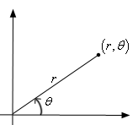
Benefits of encapsulation
Abstraction between object and clients
Protects object from unwanted access
Example: Can't fraudulently increase an Account's balance.
Can change the class implementation later
Example: Point could be rewritten in polar coordinates (r, θ) with the same methods.
Can constrain objects' state (invariants)
Example: Only allow Accounts with non-negative balance.
Example: Only allow Dates with a month from 1-12.

Slide 56
The this keyword
this : Refers to the implicit parameter inside your class.
(a variable that stores the object on which a method is called)
Refer to a field: this.field
Call a method: this.method(parameters);
One constructor this(parameters); can call another:

Slide 57
Variable shadowing
shadowing: 2 variables with same name in same scope.
Normally illegal, except when one variable is a field.
public class Point {
private int x;
private int y;
...
// this is legal
public void setLocation(int x, int y) {
...
}
In most of the class, x and y refer to the fields.
In setLocation, x and y refer to the method's parameters.

Slide 58
Fixing shadowing
public class Point {
private int x;
private int y;
...
public void setLocation(int x, int y) {
this.x = x;
this.y = y;
}
}
Inside setLocation,
To refer to the data field x, say this.x
To refer to the parameter x, say x

Slide 59
Calling another constructor
public class Point {
private int x;
private int y;
public Point() {
this(0, 0); // calls (x, y) constructor
}
public Point(int x, int y) {
this.x = x;
this.y = y;
}
...
}
Avoids redundancy between constructors
Only a constructor (not a method) can call another constructor

Slide 60
Static methods/fields

Slide 61
Multi-class systems
Most large software systems consist of many classes.
One main class runs and calls methods of the others.
Advantages:
code reuse
splits up the program logic into manageable chunks
Main Class #1
main
method1
method2
Class #2
method3
method5
Class #3
method4
method6

Slide 62
Redundant program 1
// This program sees whether some interesting numbers are prime.
public class Primes1 {
public static void main(String[] args) {
int[] nums = {1234517, 859501, 53, 142};
for (int i = 0; i < nums.length; i++) {
if (isPrime(nums[i])) {
System.out.println(nums[i] + " is prime");
}
}
}
// Returns the number of factors of the given integer.
public static int countFactors(int number) {
int count = 0;
for (int i = 1; i <= number; i++) {
if (number % i == 0) {
count++; // i is a factor of the number
}
}
return count;
}
// Returns true if the given number is prime.
public static boolean isPrime(int number) {
return countFactors(number) == 2;
}
}

Slide 63
Redundant program 2
// This program prints all prime numbers up to a maximum.
public class Primes2 {
public static void main(String[] args) {
Scanner console = new Scanner(System.in);
System.out.print("Max number? ");
int max = console.nextInt();
for (int i = 2; i <= max; i++) {
if (isPrime(i)) {
System.out.print(i + " ");
} }
System.out.println();
}
// Returns true if the given number is prime.
public static boolean isPrime(int number) {
return countFactors(number) == 2;
}
// Returns the number of factors of the given integer.
public static int countFactors(int number) {
int count = 0;
for (int i = 1; i <= number; i++) {
if (number % i == 0) {
count++; // i is a factor of the number
} }
return count;
}
}

Slide 64
Classes as modules
module: A reusable piece of software, stored as a class.
Example module classes: Math, Arrays, System
// This class is a module that contains useful methods
// related to factors and prime numbers.
public class Factors {
// Returns the number of factors of the given integer.
public static int countFactors(int number) {
int count = 0;
for (int i = 1; i <= number; i++) {
if (number % i == 0) {
count++; // i is a factor of the number
}
}
return count;
}
// Returns true if the given number is prime.
public static boolean isPrime(int number) {
return countFactors(number) == 2;
}
}

Slide 65
More about modules
A module is a partial program, not a complete program.
It does not have a main. You don't run it directly.
Modules are meant to be utilized by other client classes.
Syntax:
class.method(parameters);
Example:
int factorsOf24 = Factors.countFactors(24);

Slide 66
Using a module
// This program sees whether some interesting numbers are prime.
public class Primes {
public static void main(String[] args) {
int[] nums = {1234517, 859501, 53, 142};
for (int i = 0; i < nums.length; i++) {
if (Factors.isPrime(nums[i])) {
System.out.println(nums[i] + " is prime");
}
}
}
}
// This program prints all prime numbers up to a given maximum.
public class Primes2 {
public static void main(String[] args) {
Scanner console = new Scanner(System.in);
System.out.print("Max number? ");
int max = console.nextInt();
for (int i = 2; i <= max; i++) {
if (Factors.isPrime(i)) {
System.out.print(i + " ");
} }
System.out.println();
}
}

Slide 67
Modules in Java libraries
// Java's built in Math class is a module
public class Math {
public static final double PI = 3.14159265358979323846;
...
public static int abs(int a) {
if (a >= 0) {
return a;
} else {
return -a;
}
}
public static double toDegrees(double radians) {
return radians * 180 / PI;
}
}
Notes:
You can even open the code for Math.java in the Java src.zip install file in the JDK folder.

Slide 68
Static members
static: Part of a class, rather than part of an object.
Object classes can have static methods and fields.
Not copied into each object; shared by all objects of that class.
class
state: private static int staticFieldA private static String staticFieldB
behavior: public static void someStaticMethodC() public static void someStaticMethodD()
object #1
state: int field2 double field2
behavior: public void method3() public int method4() public void method5()
object #2
state: int field1 double field2
behavior: public void method3() public int method4() public void method5()
object #3
state: int field1 double field2
behavior: public void method3() public int method4() public void method5()

Slide 69
Static fields
private static type name;
or,
private static type name = value;
Example:
private static int theAnswer = 42;
static field: Stored in the class instead of each object.
A "shared" global field that all objects can access and modify.
Like a class constant, except that its value can be changed.

Slide 70
Accessing static fields
From inside the class where the field was declared:
fieldName // get the value
fieldName = value; // set the value
From another class (if the field is public):
ClassName.fieldName // get the value
ClassName.fieldName = value; // set the value
generally static fields are not public unless they are final
Exercise: Modify the BankAccount class shown previously so that each account is automatically given a unique ID.
Exercise: Write the working version of FratGuy.

Slide 71
BankAccount solution
public class BankAccount {
// static count of how many accounts are created
// (only one count shared for the whole class)
private static int objectCount = 0;
// fields (replicated for each object)
private String name;
private int id;
public BankAccount() {
objectCount++; // advance the id, and
id = objectCount; // give number to account
}
...
public int getID() { // return this account's id
return id;
}
}

Slide 72
Static methods
// the same syntax you've already used for methods
public static type name(parameters) {
statements;
}
static method: Stored in a class, not in an object.
Shared by all objects of the class, not replicated.
Does not have any implicit parameter, this; therefore, cannot access any particular object's fields.
Exercise: Make it so that clients can find out how many total BankAccount objects have ever been created.

Slide 73
BankAccount solution
public class BankAccount {
// static count of how many accounts are created
// (only one count shared for the whole class)
private static int objectCount = 0;
// clients can call this to find out # accounts created
public static int getNumAccounts() {
return objectCount;
}
// fields (replicated for each object)
private String name;
private int id;
public BankAccount() {
objectCount++; // advance the id, and
id = objectCount; // give number to account
}
...
public int getID() { // return this account's id
return id;
}
}

Slide 74
Summary of Java classes
A class is used for any of the following in a large program:
a program : Has a main and perhaps other static methods.
example: GuessingGame, Birthday, MadLibs, CritterMain
does not usually declare any static fields (except final)
an object class : Defines a new type of objects.
example: Point, BankAccount, Date, Critter, FratGuy
declares object fields, constructor(s), and methods
might declare static fields or methods, but these are less of a focus
should be encapsulated (all fields and static fields private)
a module : Utility code implemented as static methods.
example: Math

